Slide 1
FLASH ID In Depth

Slide 2
Review of Key Concepts
The combination of an isomorphism class and a shape class defines a Grapheme Type.
Writing is modeled at the Grapheme Type level.
The physical measurements of the Graphemes at each Grapheme Type level are used to discriminate differences between Writers.
Stored data from the discriminant analyses at the Grapheme Type level are used to identify the Writers of Test Documents.
Test Documents are analyzed using the same algorithms, producing Analysis Graphemes
The Analysis Graphemes are compared to the Grapheme Type Models to produce scores for each Reference Writer for each Analysis Grapheme
Those scores are aggregated to produce a score for each Reference Writer

Slide 3
FLASH ID: Building Reference Sets
For each page in the Reference Set:
Ingest Image
Generate Graphemes
Encode Graphemes
Generate Isomorphic Key
Generate Shape Code
Extract Physical Features for each Grapheme
For the Reference Set
Generate a Competitive Matrix for Each Grapheme Type
Compute the Canonical Variable data for the Competitive Matrices
Store the results

Slide 4
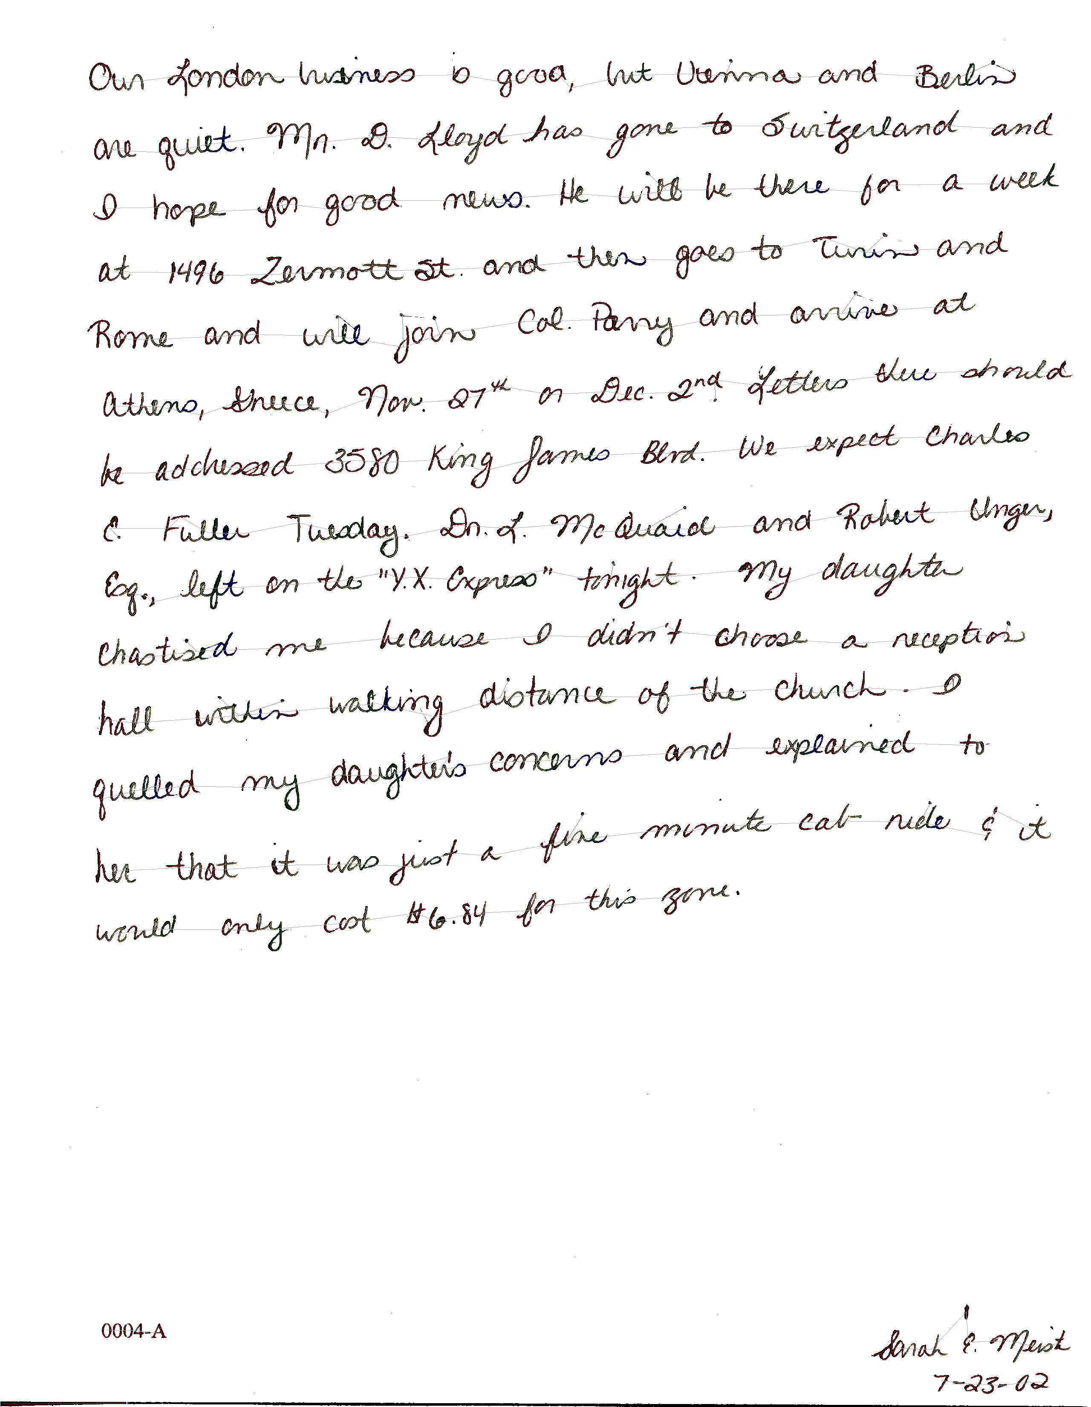
Page Processing 1: Ingest Image
Sentence pathways are established for a page of handwritten text.
Each connected segment of ink is converted to a graph containing vertices and edges.
Those graphs are too complex for matching and are segmented into simpler “graphemes” using an algorithm tailored to the language.

Slide 5
Enrollment Step 2: Generate Graphemes
Rules for Grapheme Creation For English:
Rules For Breakpoints
Determine a base curve path for a given segmentation graph, creating an ordered set of edges from left to right
For each edge, walk the candidate edge along its pixels in order
When a "trough" occurs, add the “lowest” point of the trough to the candidate break point set.
If there are no “trough” breakpoints defined for the edge, take the midpoint of the edge as the sole member of the candidate trough point set.
Take the set of candidate break points for the edge, and determine the subset of these breakpoints such that no members of the set can be described as an "Illegal Break" (described below)
These are the ordered set of break points for the edge
This is done for all base curve path edges, determining a set of ordered break points, which become the boundary points for the ordered set of graphemes.
Take any neighboring graphemes that are stacked on top of each other within a given threshold, combine them into one grapheme.
Illegal Breaks:
No breaking occurs for single stroke edges.
No breaking occurs for edges where either vertex has an order of 1 . (order is the number of edges that a given vertex is a part of)
No breaking occurs on edges with less than 11 pixels.
No breaking occurs on any edge where a path exists between the 2 vertices of the edge that does not contain the edge itself
No breaking occurs twice on one edge within 25 pixels (if this occurs, the higher y-Coordinate break is taken).
No breaking occurs within 5 pixels to a vertex.
No breaking occurs on any point that 2 or more edges have in common.

Slide 6


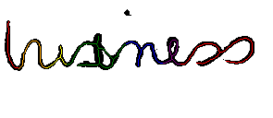
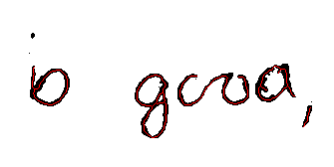
Enrollment Step 2: Generate Graphemes
Examples of grapheme segmentation

Slide 7


Enrollment Step 2: Generate Graphemes
Fused Graphemes: Using the concept of a “sliding window” adjacent graphemes are combined to create “fused graphemes”.
Original Graphemes (Window size equals 1)
Fused Graphemes (Window size equals 2)
Fused Graphemes (Window size equals 3)

Slide 8
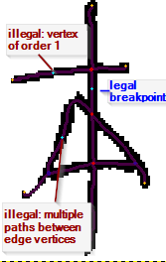
Enrollment Step 2: Generate Graphemes
Rules for Grapheme Creation For Chinese:
Rules For Breakpoints
Breaking can occur at the midpoint of every edge that’s two vertices have an order greater than or equal to 3.
Breaking only occurs at the above midpoints if breaking at a given single edge would create 2 completely separated graphs (i.e. the only path between the two involved vertices is the edge itself).
Illegal Breaks:
No breaking occurs for edges with less than 5 pixels.

Slide 9
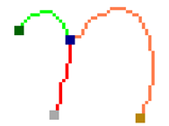
Enrollment Step 3.1: Generate Isomorphic Key
Order vertices by decreasing connectivity
Create a adjacency matrix for the vertices
Put a “1” in each cell containing connected vertices
Create binary numbers in groups of eight, reading left to right, top to bottom (zero pad final group on the right)
01110000.00000000
Create ISO key from vertex count and generated number in decimal
4;112.0
B
A
D
C
 | A | B | C | D
A | 0 | 1 | 1 | 1
B |  | 0 | 0 | 0
C |  |  | 0 | 0
D |  |  |  | 0
Vertex count
1st group
2nd group

Slide 10
Enrollment Step 3.1: Generate Isomorphic Key
Additional rules to deal with:
Ordering of vertices with same number of connections
Vertices connected by more than one edge
End result in an encoding that describes the topology of a graph (Isomorphic Key)
The isomorphic Key is used in conjunction with shape code to group graphemes for comparison

Slide 11






Enrollment Step 3.1: Generate Isomorphic Key
Graphic Topological Isomorphism Examples:
Isomorphic Code: 2;192
Schematic:
Examples:
O in “Our”: a in “has”
upper case “I” o in “good”
9 and 6 in “1496”

Slide 12




Enrollment Step 3.1: Generate Isomorphic Key
Isomorphic Code: 3;224
Schematic:
Examples:
e in “Berlin”: l in “explained”:
8 in “$6.84”:

Slide 13





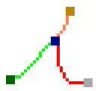

Enrollment Step 3.1: Generate Isomorphic Key
Isomorphic Code: 4;112.0
Schematic:
Examples:
n in “London”:
e in “there”:
r in “there”:

Slide 14





Enrollment Step 3.1: Generate Isomorphic Key
Isomorphic Code: 4;98.0:64.0
Schematic:
Examples:
d in “and”: A in “Athens”:
s in “should”: p in “expect”:

Slide 15
Enrollment Step 3.2: Generate Shape Code
A grapheme is further characterized by its shape code
The shape code is a compact numeric structure that describes the overall shape of a graph.
Along, with the Isomorphic Key, it creates meaningful sets of similar graphemes for comparison

Slide 16
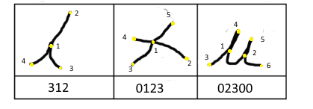
Enrollment Step 3.2: Generate Shape Code
Shape Code: A numeric encoding based on compass direction between the “prime vertex” and all other vertices.
Compass directions split into 4 sections, each given a number 0, 1, 2 or 3
3
2
0
1

Slide 17
Enrollment Step 4: Extract Physical Features
List of major feature classes that support graph classifications:
Component Distance
The physical distance between graph edges and vertices.
Component Direction
The direction from graph edges and vertices to each other.
Centroid Distance
The physical distance from individual graph edges and vertices to the center of mass of the graph.
Centroid Direction
The direction from graph edges and vertices to the center of mass of the graph.
Exit Direction at Vertex
The direction an edge exits a vertex.
Skew
The angular direction of an edge.
Edge Aspect Ratio
The ratio of the height and width of a bounding box containing an edge.
Edge Length
The actual path length along an edge.
Bending Energy
The amount of curvature in an edge.
Bezier Values
Point based curve descriptors that capture curve shape.

Slide 18
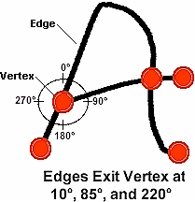
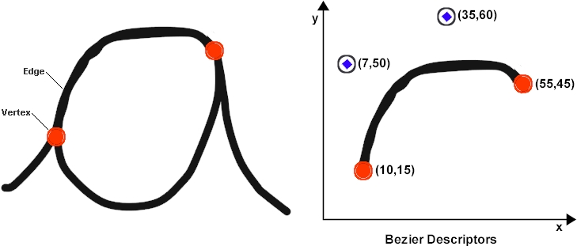
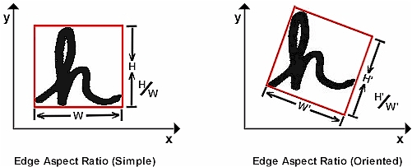
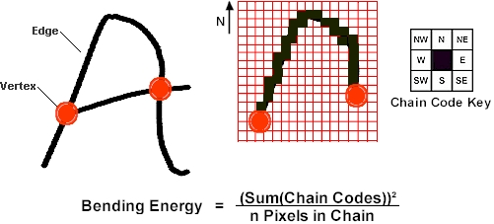
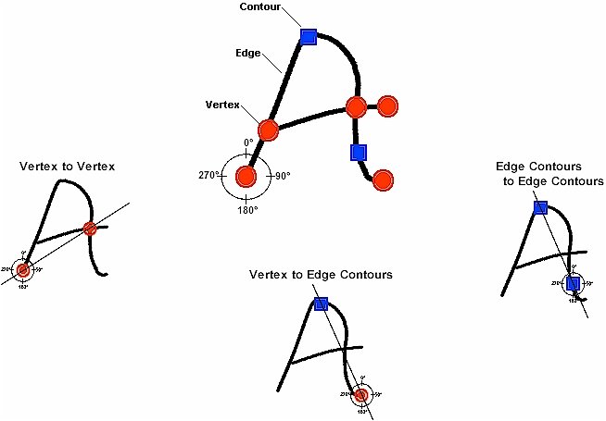
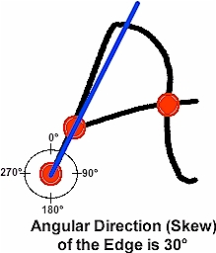
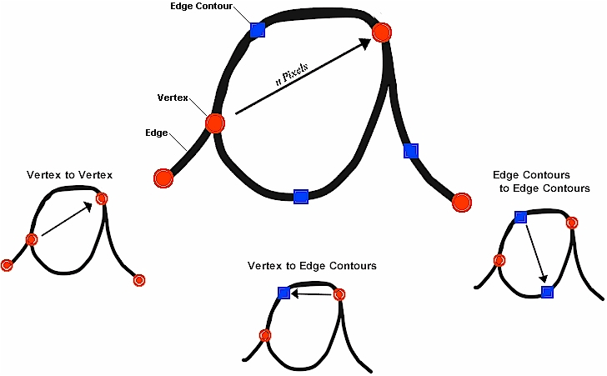
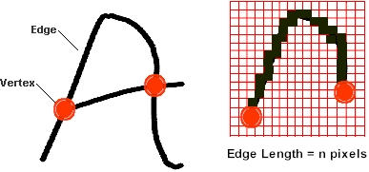
Enrollment Step 4: Extract Physical Features
Distance Features
Directional Features
Aspect Ratios Bending Energy Edge Path Length Bezier Offsets

Slide 19
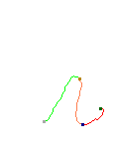

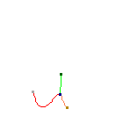

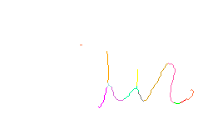
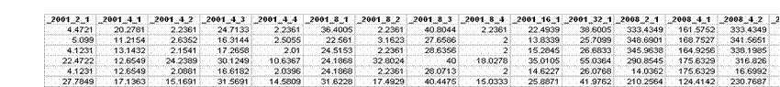
Enrollment Step 4: Extract Physical Features
Create Data Structure: A data record is created for each grapheme encompassing the Isomorphic Key/Shape Code and Physical Data
Writing-based Graphemes
Extracted Data
Isomorphic Key/Shape Code
+

Slide 20
Enrollment Step 5: Build Reference Database
The Feature Vectors for each Grapheme Type are the basis of biometric comparison for the Handwriting
The Curse of Dimensionality: Feature Vectors are high dimensional.
The Isomorphism (4;112.0) has 199 measurements in its Feature Vector.
For a pair of writers and a particular Grapheme Type, there may be only a few of the measurements that carry meaningful information to discriminate between the writing of the two writers.
For another pair of writers and the same Grapheme Type, the few meaningful measurements are likely to be different from those used for the first pair of writers.

Slide 21
Enrollment Step 5: Build Reference Database
Reduce the Dimensionality
We can use the collected information to determine which features provide the most useful information
For each Grapheme Type, all writers from the Reference Set (R) with minimum number of instances of the Grapheme Type are used to form a Competitive Matrix with a known set of non-matching Writers (C).
Each of the R writers forms one row and each of the C writers forms one column in the Competitive Matrix.
For each pair of writers (cell in the Matrix), Statistical Linear Discriminant Analysis ( LDA) is used to find a canonical variable (combination of Feature Vector measurements and coefficients) that separates the Grapheme Type data for these writers.
Non-matching Writers also referred to as a Base Set

Slide 22
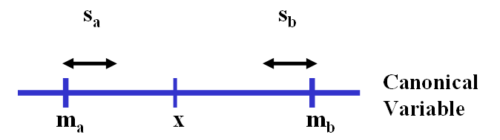
Enrollment Step 5: Build Reference Database
For each cell (pair of writers) in the competitive matrix:
Compute the canonical coefficients (via LDA) to best distinguish the two writers for this Grapheme Type.
Compute the canonical variable for each instances of the Grapheme Type: canonical variable = r₁*x₁ + r₂*x₂ + … + r_{n}*x_{n}
where x₁, x₂, … x_{n} are features and
r₁, r₂, … r_{n} are coefficients.
Compute the mean and standard deviation of the canonical variables for each writer’s training data.
Store the canonical coefficients and each writer’s mean and standard deviation for the canonical variable.

Slide 23
Enrollment Step 5: Build Reference Database
The Reference Data Base consists of the Competitive Matrices for all Grapheme Types that have a minimum number of writers with a minimum number of instances of the Grapheme type.
Topology
Shape Code
s₁ s₂ s₃ s₄ s₅ s₆ s_{t-4} s_{t-3} s_{t-2} s_{t-1} s_{t}
4;112.0
 | 1 | 2 | … | C
1
2
3
…
R
Competitive matrix for a Grapheme Type (e.g. 4;112.0/312)

Slide 24
Scoring: Comparison Process Overview
Biometric Comparison
Enroll Test Document
For each Grapheme instance:
Compare to Reference Database Competitive Matrix
Compute Scores for Each Reference Set Writer
Generated Ranked List

Slide 25
Scoring Summary
Each Grapheme in the Questioned Writing is the basis for awarding a score to each Reference Set Writer.
The Competitive Matrix scoring structure provides writer scores corresponding to each Grapheme in the Questioned Writing.
Each Reference Set Writer is ranked by aggregating all of their scores against each Grapheme

Slide 26
Scoring for Each Test Document Grapheme
Steps for each test grapheme:
For each cell in the appropriate Grapheme Type Competitive Matrix, recall the information stored in training and do the following:
Compute the canonical variable for the test grapheme using the coefficients for that cell.
Convert the canonical variable to a row writer z-score AND a column writer z-score using the following formula. Thus there are two z-scores for each cell.
canonical variable = r₁*x₁ + r₂*x₂ + … + r_{n}*x_{n} where x₁, x₂, … x_{n} are features and r₁, r₂, … r_{n} are coefficients.

Slide 27
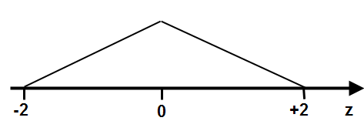
Scoring for Each Test Document Grapheme (Cont’d)
3) Convert each of the TWO z-scores in a cell to a “reward*” between 0 and 1. The reward function used is a “triangle” with value of one when the z-score is zero tapering down to zero when the absolute value of the z-score is two or more.
* Note that each writer in a cell can get some reward.

Slide 28
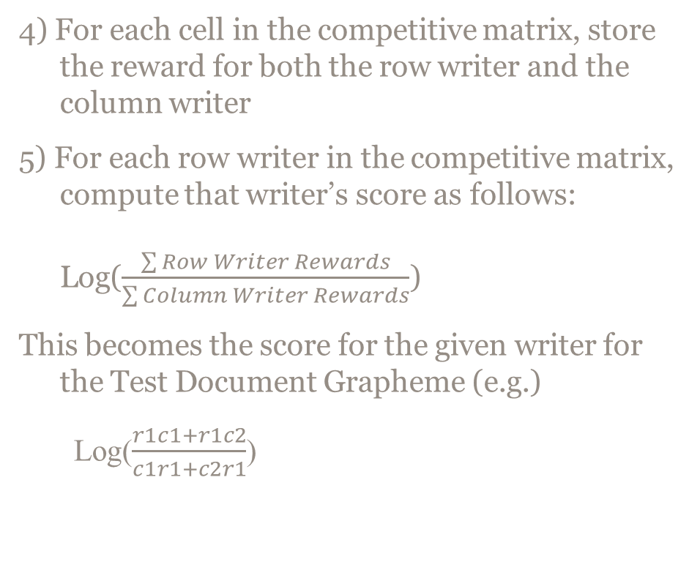
Scoring for Each Test Document Grapheme (Cont’d)
C1
C2
R1
c1r1
c2r1
r1c1
r1c2
R2
r2c1
c2r2
r2c1
r2c2

Slide 29
Scoring for Each Test Document
Sum the individual Test Document Grapheme scores for each Row Writer in the Reference Set and rank the Row Writers based on the total score

Slide 30
Creating a Reference Set

Slide 31
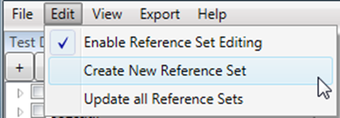
Creating Reference Sets
FLASH ID provides a tool to create new Reference Sets
A Reference Set consists of a Base Set of Documents, a Reference Set of Documents, and configuration options to guide the processing
Configuration Options:
Language of the writing
Writing style (Cursive vs Print, English only)
Author Length
Authorship of the known writing is encoded in the filenames of the documents
Start via the Edit->Create New Reference Set Menu Item

Slide 32
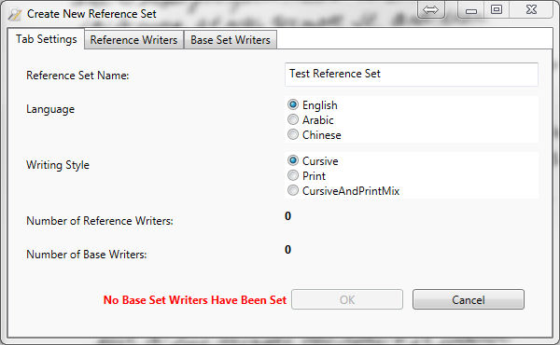
Select Reference Set Language

Slide 33
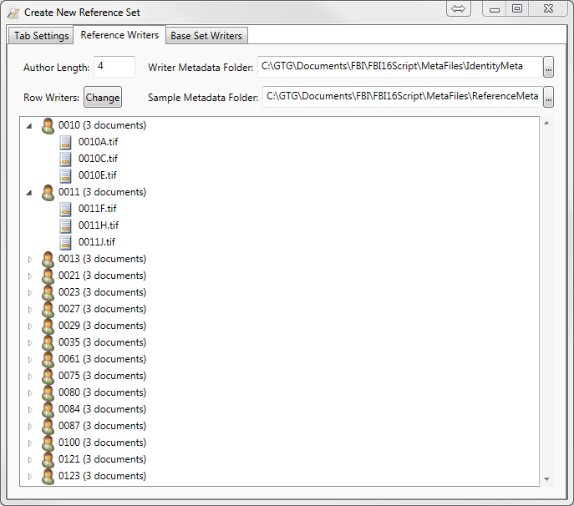
Select Reference Set Documents and Metadata

Slide 34
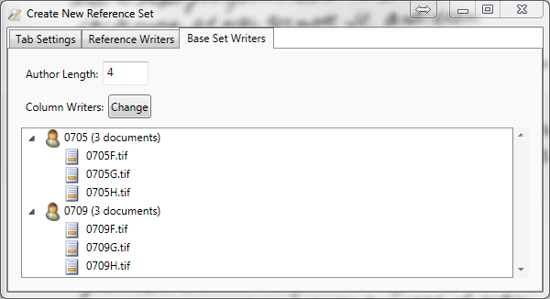
Select Base Set Documents
This is the non-matching set of writers referred to earlier. Reference Writes and
Base Set Writers are used to form the competitive matrices.

Slide 35
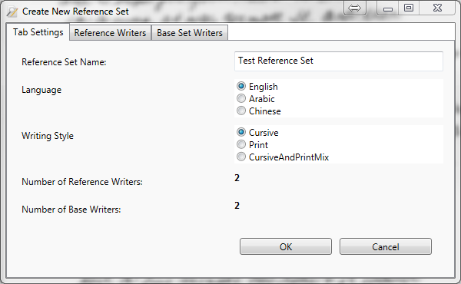
Start Create Reference Set Process

Slide 36
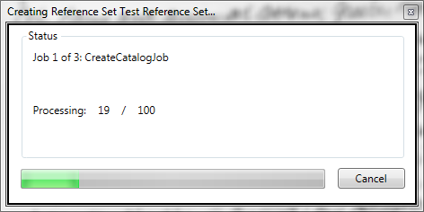
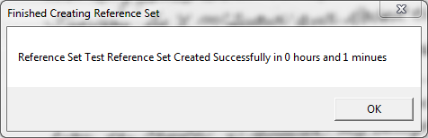
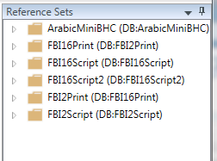
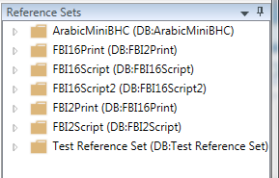
Create Reference Set Status

Slide 37
Reference Set Maintenance

Slide 38
Modifying Reference Sets
FLASH ID provides the following features:
Add/Delete Writer
Add/Delete Document
Move Documents between Writers
Changes to a Reference Set result in a new Snapshot being created
Snapshot maintains a history of the Reference Sets
Old Snapshots can be deleted when no longer required

Slide 39

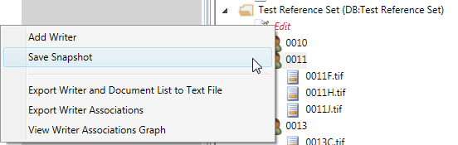
Reference Set Editing Mode
Enabled via the Edit->Enable Reference Set Editing Menu Item
An “Edit” Snapshot is shown in each Reference Set
All edits to a Reference Set are made to this “Edit” Snapshot
Edits are saved to a new Snapshot by right-clicking on the “Edit” Snapshot and selecting Save Snapshot

Slide 40
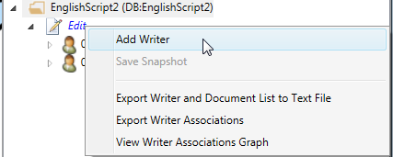
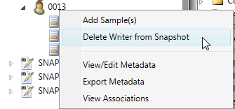
Add/Delete Writer
Add Writer by right-clicking in the “Edit” Snapshot and selecting Add Writer
Enter a name for the Writer in the dialog box that is displayed
Delete a Writer by right- clicking on a Writer and selecting Delete Writer From Snapshot

Slide 41
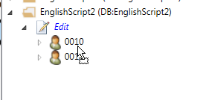

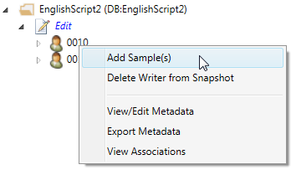
Add Documents
Documents can be added to a Reference Set from the Test Documents List
Documents are added to a Reference Set Writer by clicking the checkbox next to the Test Document name, then clicking and dragging the Test Document to the Reference Set and dropping on the desired Writer
The mouse cursor changes to until it is positioned over a Reference Set Writer name
Documents can also be added by right-clicking on a Writer name and selecting Add Sample(s)

Slide 42
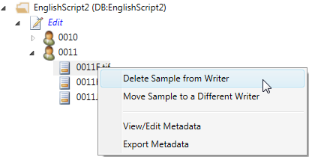
Delete Document
Documents are deleted by right- clicking on a document name and selecting Delete Sample From Writer

Slide 43
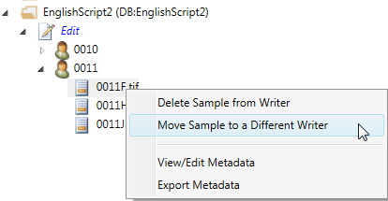
Move Document
Drag and Drop editing is supported to move documents from one Writer to another within a Snapshot
Click and drag on the document name, release over the list of documents of the destination Writer or the destination Writer’s name
Documents may also be moved by right clicking on a document and selecting Move Sample to a Different Writer

Slide 44
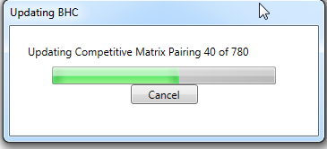
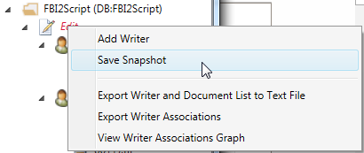
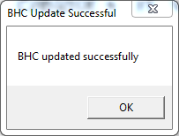
Updating the Reference Set
Once all edits are complete, the Reference Set changes are saved by right-clicking on the “Edit” Reference Set Snapshot and selecting Save Snapshot
A progress dialog is displayed, followed by a completion dialog
Once the update is complete, a new Snapshot is saved

Slide 45
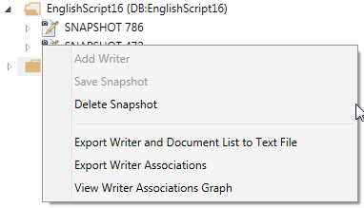
Old Snapshots
Recognitions are saved with the ID of the Reference Set Snapshot that was used
Changes to the Reference Set preserves the old snapshots (and recognition results) until they are deleted by the User
Old Snapshot can be deleted by right clicking on a Snapshot name and selecting Delete Snapshot

